Slide 1

Created by Steven Trotta, CJ Miller, and Trent Punt

Slide 2
Create Game
Join Game
Exit

Slide 3
Create Game
Select User Name:
(this is a popup on top of the setup menu)
Submit

Slide 4
Create Game
Setup
Game Name:
Max Players:
Maximum Time Allowed Per Turn:
Create Game

Slide 5
Join Game
Select User Name:
(this is a popup on top of the Join menu)
Submit

Slide 6
Games Being Set Up
Game Name Game Creator Number of Players
Game1 Jim 2/4
Awesome Game CatanMaster12 3/4
Join
Join

Slide 7
Awesome Game Lobby
Player Name Status
Steve Not Ready
Snowboardman Not Ready
Jim Bob Ready
Lil’ Bobby Tables Ready
Ready Up
Start

Slide 8






Generating Board

Slide 9
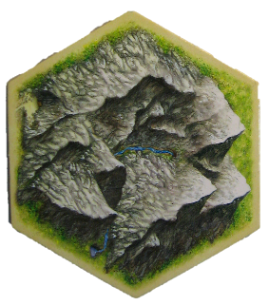

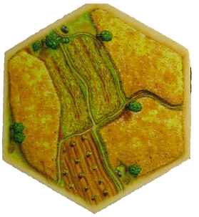

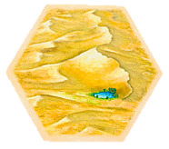


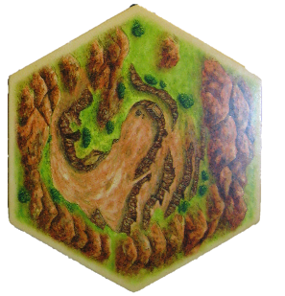
Player 3
3
10
4
Player 2
Player 4
11
9
3
8
4
10
6
8
6
5
12
11
Chat
2
9
5

Slide 10
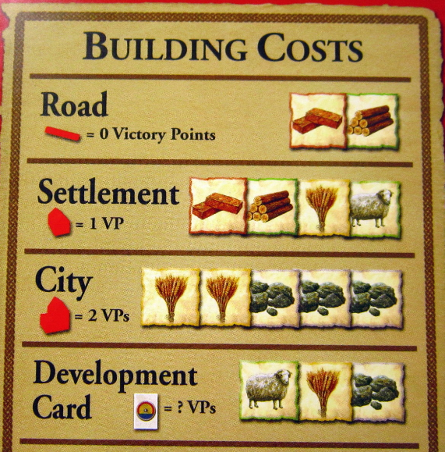
Put down 1 settlement and one road
Player 3
DONE
3
10
4
Player 2
Player 4
11
9
3
8
4
10
6
8
6
5
12
11
Chat
2
9
5

Slide 11
Waiting for player <x> to place 1 settlement and one road
Player 3
3
10
4
Player 2
Player 4
11
9
3
8
4
10
6
8
6
5
12
11
Chat
2
9
5

Slide 12
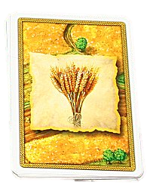
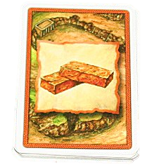

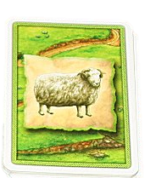

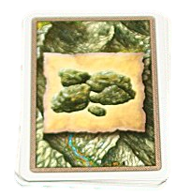
Player 3
3
10
4
Player 2
Player 4
11
9
3
Let the Game Begin!
8
4
10
6
8
6
5
12
11
Chat
2
9
5

Slide 13
Player 3
Trade
DONE
Trading Phase: Press ‘done’ when finished
3
10
4
Player 2
Player 4
Trade
11
9
3
Trade
8
4
10
6
8
6
5
12
11
Chat
2
9
5

Slide 14



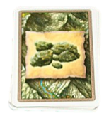
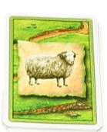
Player 3
Trade
DONE
Trading Phase: Press ‘done’ when finished
Trade with Player
3
10
4
Two
Player 2
Trade____
For____
Player 4
Trade
11
9
3
Trade
1
8
4
10
6
2
8
6
5
12
11
Cancel
Trade
Chat
2
9
5

Slide 15
Player 3
DONE
Build Phase: Press ‘done’ when finished
3
10
4
Player 2
Player 4
11
9
3
8
4
10
6
8
Click the box below to build
6
5
12
11
Chat
2
9
5

Slide 16
Player 3
DONE
Build Phase: Press ‘done’ when finished
3
10
4
Player 2
Player 4
11
9
3
8
4
10
6
8
Click the box below to build
6
5
12
11
Chat
2
9
5

Slide 17
Waiting for player <x> to trade
Player 3
3
10
4
Player 2
Player 4
11
9
3
8
4
10
6
8
6
5
12
11
Chat
2
9
5

Slide 18
Waiting for player <x> to build
Player 3
3
10
4
Player 2
Player 4
11
9
3
8
4
10
6
8
6
5
12
11
Chat
2
9
5

Slide 19
Player 3
Game Over! Player 1 Wins!
Statistics
Player Victory Points Number of Settlements Number of Cities
1 10 4 3
2 8 2 2
3 7 2 2
4 6 1 2
3
10
4
Player 2
Player 4
11
9
3
8
4
10
6
8
6
5
12
11
Chat
2
9
5
Quit

